Slide 1
Media Access sublayer

Slide 2

Data link sublayer

Slide 3
When nodes or stations are connected and use a common link ,called a multipoint or broadcast link , we need multiple access protocol to coordinate access to the link .

Slide 4
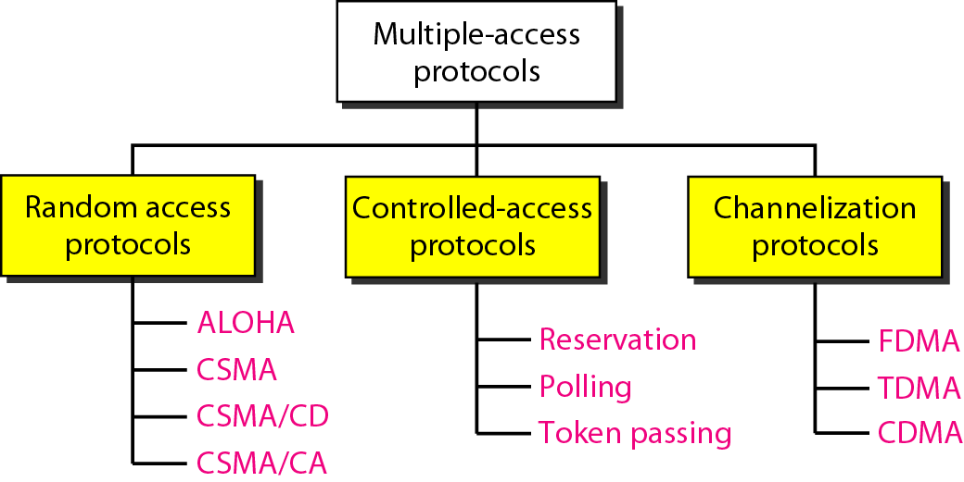
Figure 12.2 Taxonomy of multiple-access protocols discussed in this chapter

Slide 5
12-1 RANDOM ACCESS
In random access or contention methods, no station is superior to another station and none is assigned the control over another.
No station permits, or does not permit, another station to send.
At each instance, a station that has data to send uses a procedure defined by the protocol to make a decision on whether or not to send.
ALOHA
Carrier Sense Multiple Access
Carrier Sense Multiple Access with Collision Detection
Carrier Sense Multiple Access with Collision Avoidance

Slide 6
ALOHA :
Original ALOHA protocol is called pure ALOHA.
Pure ALOHA
If you have a packet, just send it.
If multiple people try it and so there is collision, then try resending it later!
Theoretical analysis (based on Poisson distribution) shows a throughput of only 18%.

Slide 7
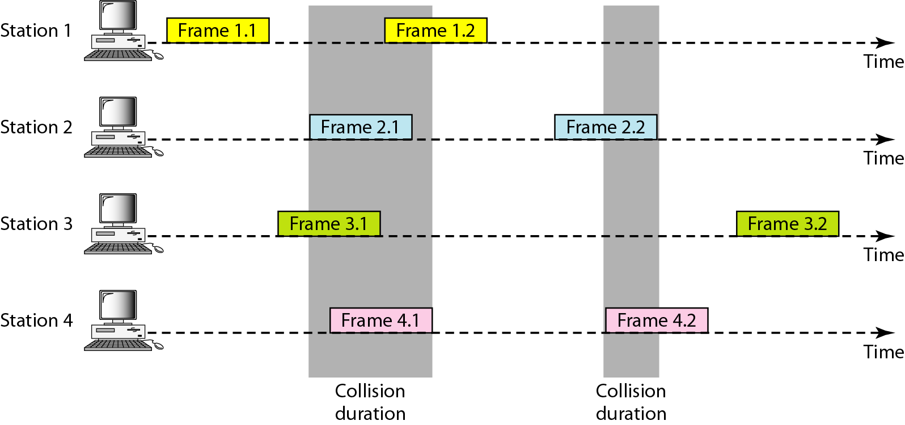
Figure 12.3 Frames in a pure ALOHA network

Slide 8
Here frame 1.1 from station1 and frame 3.2 from station 3 will
survive.
So we need to resend the frame that have been destroyed
during transmission.
When a station sends a frame ,it expects the receiver to send an
acknowledgment.
If the ack doesn’t arrive after time out period,the station
assumes that the frame has been destroyed and resend the frame.
A collision involves 2 or more stations
If all these station try to resend their frames after the
timeout ,Each station waits a random amount of
time before resending its Frame.
This randomness will help to avoid collision.
This is called back off time.

Slide 9
Slotted ALOHA
Synchronous, that is time is divided into slots.
Slot size is equal to the transmission time of a packet.
When you are ready, transmit at the start of the time slot.
Doubles the efficiency of Aloha (38% throughput)
But requires synchronization!
Transmission Time: Avg time required to send out a frame

Slide 10
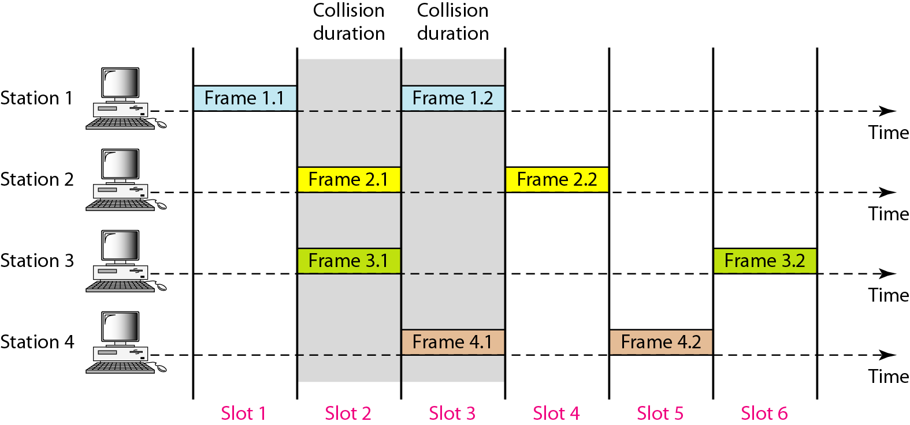
Figure 12.6 Frames in a slotted ALOHA network

Slide 11
Carrier Sense Multiple Access(CSMA)
To improve performance CSMA was developed.
The chance of collision can be reduced if a station senses the medium before trying to send.
Listen to channel. If busy then wait for a random time and then listen again.
If not busy then transmit.
Collision may still happen

Slide 12
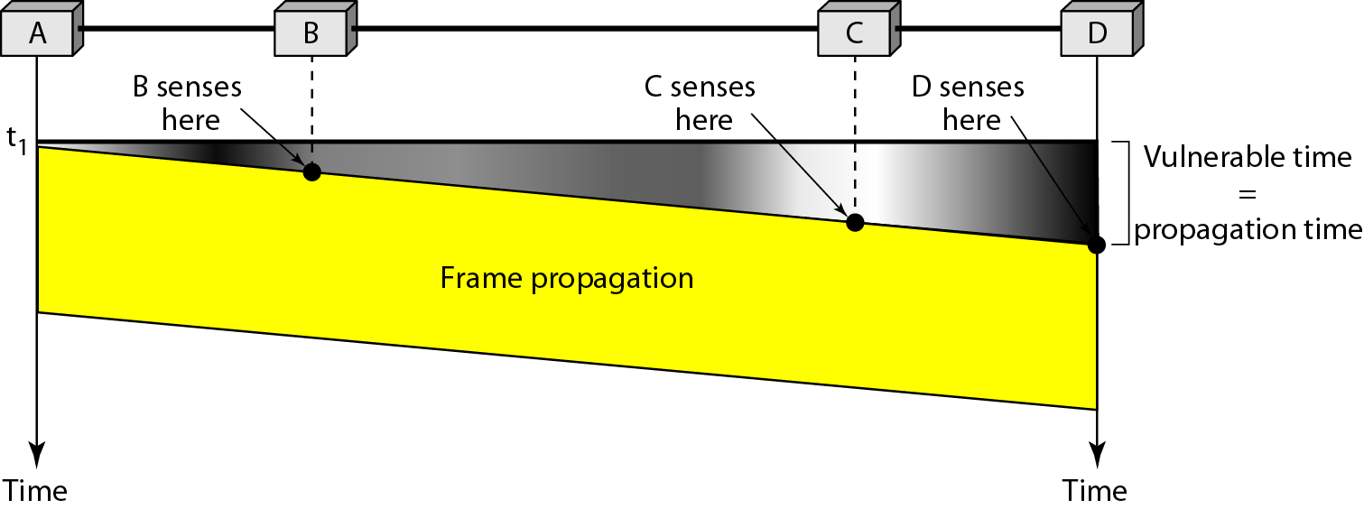
Figure 12.9 Vulnerable time in CSMA

Slide 13
Persistence Method
1-persistent :
After the station finds the line idle, it sends its frame immediately.
This method has highest chance of collision
Becoz 2 or more station may find the line idle and send their frame immediately

Slide 14
Non-persistent
A station has a frame to send senses the channel.
If line idle, it sends immediately
If busy, it waits a random amount of time and then senses the line again
Reduces the chance of collision

Slide 15
p-Persistent
Combines advantages of other two.
Reduces chance of collision and improves efficiency.
In p-persistent CSMA, when a transmitting station has a frame to send and it senses a busy channel, it waits for the end of the transmission, and then transmits with a probability p.
Since, it sends with a probability p, the name p – persistent CSMA is given.

Slide 16
ALGORITHM
When the channel becomes idle, the station transmits the frame with a probability p.
With a probability ( 1 – p ), the channel waits for next time slot. If the next time slot is idle, it again transmits with a probability p and waits with a probability ( 1 – p ).
The station repeats this process until either frame has been transmitted or another station has begun transmitting.
If another station begins transmitting, the station waits for a random amount of time.(back off algorithm) and restarts the algorithm.

Slide 17
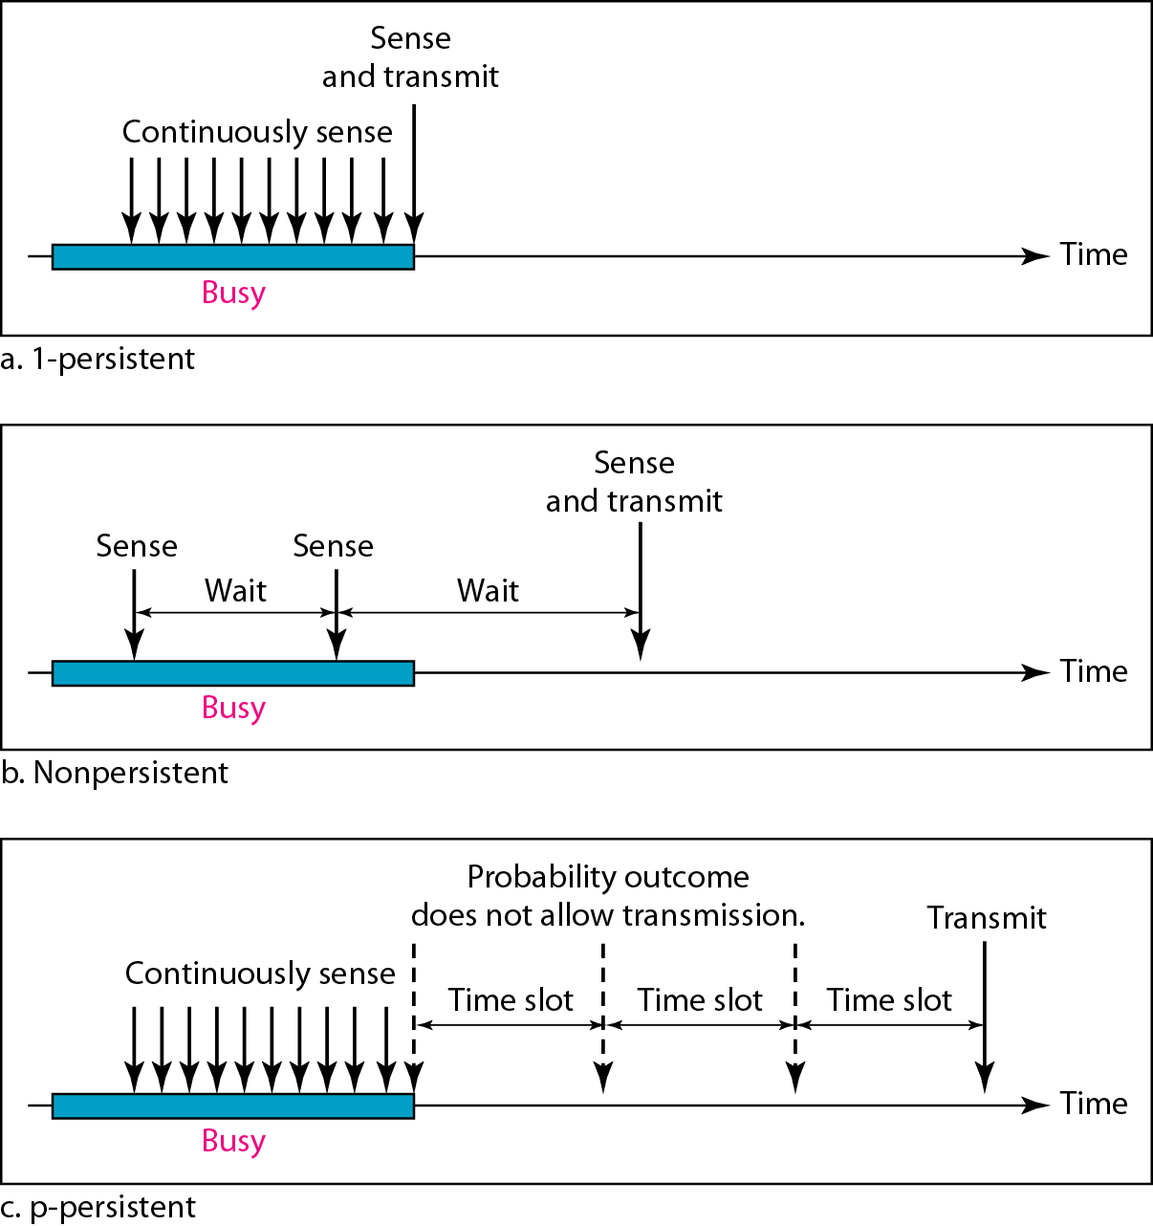
Figure 12.10 Behavior of three persistence methods

Slide 18
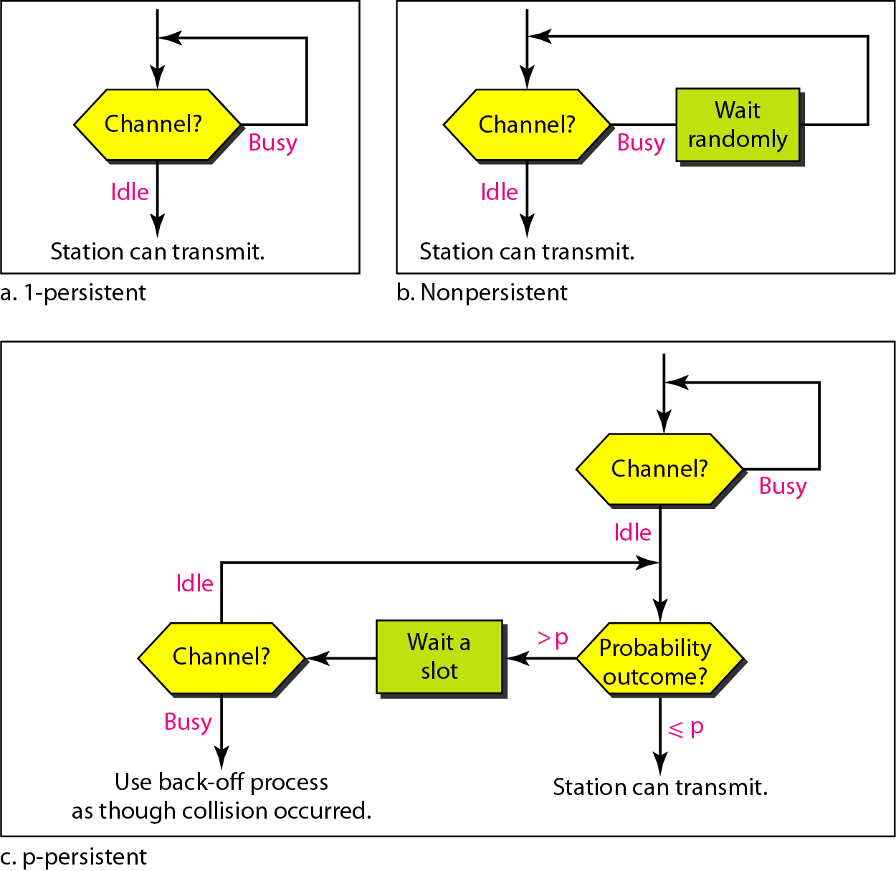
Figure 12.11 Flow diagram for three persistence methods

Slide 19
Definitions of the components/Keywords:
1
CSMA/CD is Carrier Sense Multiple Access / Collision Detection :
- Carrier Sense – the ability of a network card to sense or detect communication on the network - Multiple Access – states that in that network there are multiple stations that could access the network at the same time
- Collision Detection – the method needed for detecting a collision
Carrier Sense Multiple Access/Collision Detect (CSMA/CD) is the protocol for carrier transmission access in Ethernet networks.
Carrier-sense multiple access with collision detection describes how the Ethernet protocol regulates communication among nodes
2
3
4
5
Notes:
19

Slide 20
On Ethernet, any station can send a frame at any time.
Each station senses whether the medium is idle and therefore available for use.
If it is, the station begins to transmit its first frame.
If another station also tries to transmit at the same time, a collision occurs and the frames are discarded and then a jamming signal is sent throughout the network in order to notify all stations of the collision.
Each station then waits for a random period of time and retries.
If another collision occurs, the time intervals from which the random waiting time is selected are increased step by step. This is known as exponential back off. The stations retry until successful transmission of the frame.
CSMA/CD is specified in the IEEE 802.3 standard.

Slide 21
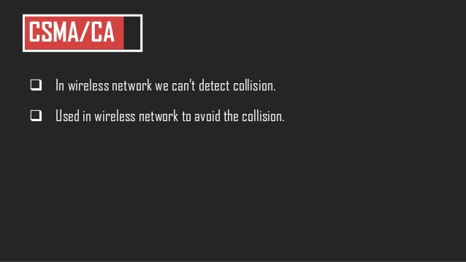

Slide 22
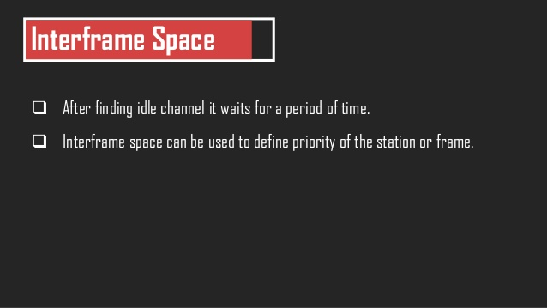

Slide 23
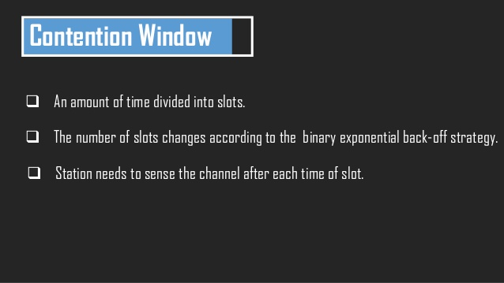

Slide 24
A station is ready to send, chooses a random number of slots as its wait time.
The number of slots in the window changes according to the binary exponential back of strategy.
It is set to one slot the first time and then doubles each time the station cannot detect an idle channel after the IFS time.

Slide 25
Acknowledgment
With all these precaution ,there still may be collision resulting in destroying data.
Also data may be corrupted during transmission
The positive acknowledgement and timeout timer can help guarantee that the receiver has received the frame.

Slide 26
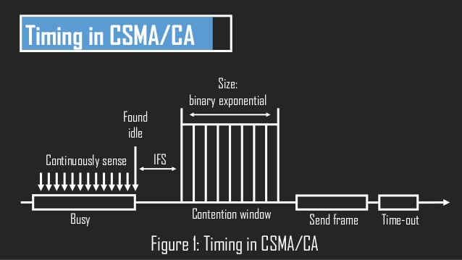

Slide 27
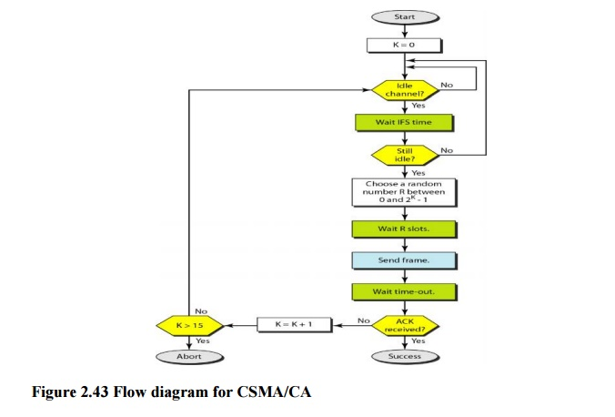

Slide 28
CONTROLLED ACCESS
the stations consult one another to find which station has the right to send.
a station cannot send unless it has been authorized by other stations.
three controlled-access methods.

Slide 29
Reservation
a station needs to make a reservation before sending data.
Time is divided into intervals.
- In each interval, a reservation frame precedes the data frames sent in that interval.

Slide 30
If there are M stations, the reservation interval is divided into M slots, and each station has one slot.
Suppose if station 1 has a frame to send, it transmits 1 bit during the slot 1. No other station is allowed to transmit during this slot.
In general, i^{th} station may announce that it has a frame to send by inserting a 1 bit into i^{th} slot.
After all N slots have been checked, each station knows which stations wish to transmit.

Slide 31
The stations which have reserved their slots transfer their frames in that order.
After data transmission period, next reservation interval begins.
Since everyone agrees on who goes next, there will never be any collisions

Slide 32
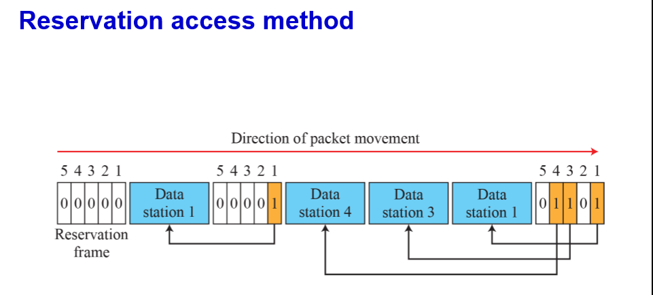

Slide 33
Polling
Polling works with topologies in which one device is designated as a primary station and the other devices are secondary stations.
All data exchanges must be made through the primary device even when the ultimate destination is a secondary device.
The primary device controls the link; the secondary devices follow its instructions.
It is up to the primary device to determine which device is allowed to use the channel at a given time.

Slide 34
Poll Function(poll) :
If primary wants to receive data,it ask the secondaries
if they have anything to send.
Select function (SEL):
If primary wants to send data ,it tells the secondary to
get ready to receive .

Slide 35
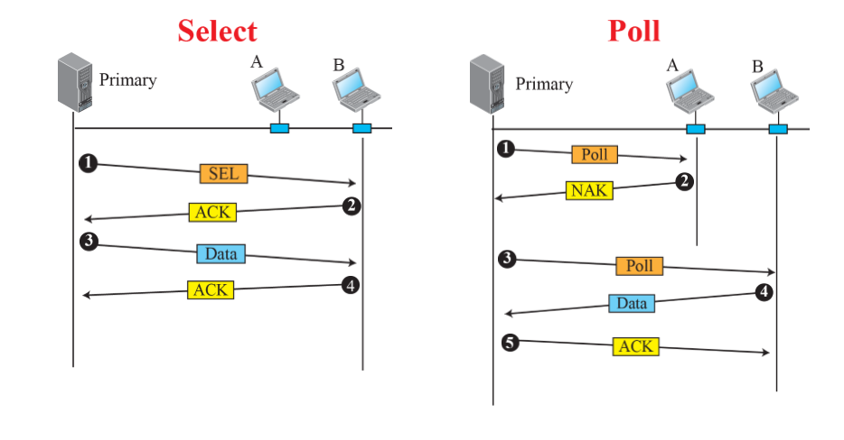

Slide 36
Token Passing
the stations in a network are organized in a logical ring.
In other words, for each station, there is a predecessor and a successor
The predecessor is the station which is logically before the station in the ring; the successor is the station which is after the station in the ring.

Slide 37
A special packet called a token circulates through the ring.
The possession of the token gives the station the right to
access the channel and send its data

Slide 38
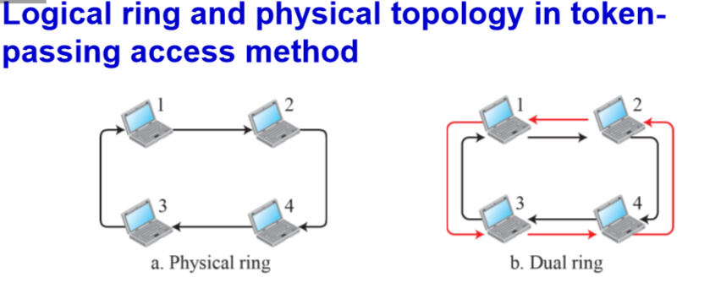

Slide 39
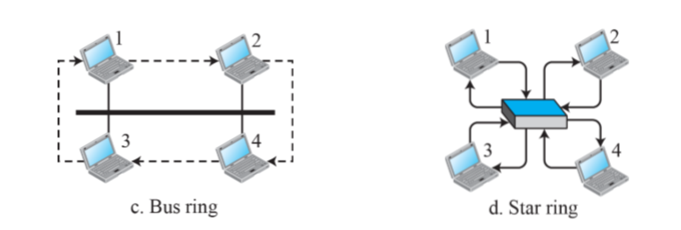

Slide 40
CHANNELIZATION
-
Channelization (or channel partition, as it is sometimes called) is a multiple-access method in which the available bandwidth of a link is shared in time, frequency, or through code, among different stations.
- three protocols: FDMA, TDMA, and CDMA.

Slide 41
FDMA
- the available bandwidth is divided into frequency bands
- Each station is allocated a band to send its data. In other words, each band is reserved for a specific station, and it belongs to the station all the time

Slide 42
TDMA
the stations share the bandwidth of the channel in time
Each station is allocated a time slot during which it can send data
- Each station transmits its data in its assigned time slot

Slide 43
CDMA
CDMA differs from FDMA in that only one channel occupies the entire bandwidth of the link
- It differs from TDMA in that all stations can send data simultaneously; there is no timesharing

